Slide 1
REVELATION 10 : 1 - 7
. . . Heavenly Angel in the Earthly Angel . . .

Slide 2
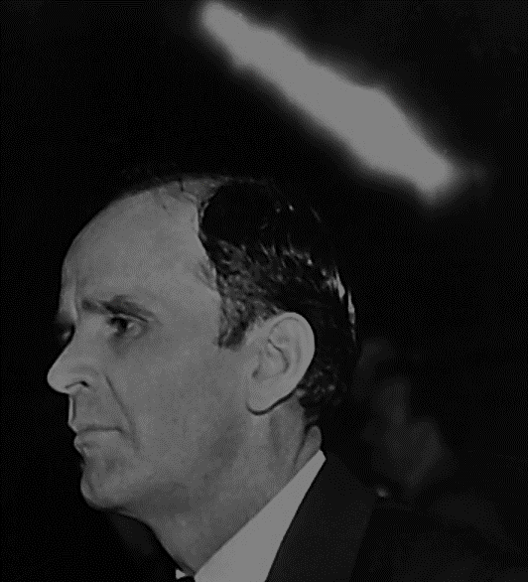
Exposition of the Church Ages: “ From My Heart to the Hearts of the People ”

Slide 3
Bro Branham was involved in the writing of a book.

Slide 4
There have been many views on the value of this book.

Slide 5
We will cover:
History
Authority
Purpose

Slide 6
We will NOT cover:
Every difference that has been voiced.

Slide 7
History

Slide 8
History
George Smith – Bro Branham’s son-in-law.
Spreading The Message around the world.

Slide 9
History
George Smith
- Bro Branham’s son-in-law.
- Sis Rebecca passed in 2006.
- Spreading The Message around the
world.
- Spoke to this week.

Slide 10
History
December of 1960 Bro. Branham preached the Seven Church Age Series.
In the opening service he says he wants to write a book (next quote).

Slide 11
60-1204M The Revelation Of Jesus Christ
10 The natural history, which is of the…taken from the most outstanding historians that I know of. I have laying in my study room, right now, about five or six commentaries, Hislop’s Two Babylons, Foxe’s Book Of The Martyrs, and other great books;

Slide 12
60-1204M The Revelation Of Jesus Christ
… like the Pre-Nicene Council, about four books on that, around four hundred pages in each book. And there the Nicene Council, and all the history that we can.

Slide 13
60-1204M The Revelation Of Jesus Christ
… Because, behind this, from the magnetic tape, we’re going to write a commentary on the Seven Church Ages, to send to all the world, that we can, because we are in the last days. We are at the end time.

Slide 14
History
Around 1961 a sister from Georgia typed out the sermons from the tapes and delivered them to Bro Branham.

Slide 15
History
Around 1962 Bro Branham begins working with Lee Vayle to put his thoughts into book from.

Slide 16
History
Drafts of the work are going back and forth between Bro Branham and Lee Vayle for around 3 years (1962-1965).

Slide 17
History
In one case Bro Branham was riding in the car with his daughter, Sis Rebecca. He asked her to read the draft to him as he drove …

Slide 18
History
… telling her “ mark out that line and write … because in a few pages it will explain this other part ”.

Slide 19
History
Around November of 1965 the Exposition of the Church Ages is released.

Slide 20
History
Bro Branham is in a major car accident on December 19, 1965.
He passes away on
December 24, 1965.

Slide 21
History
Within a very short time of the release of the book Ewald Frank, an outspoken minister from Germany, was disagreeing with some 20 details of the book.

Slide 22
Authority

Slide 23
REVELATION 10 : 1 - 7
. . . Heavenly Angel in the Earthly Angel . . .

Slide 24
MALACHI 4 : 5 - 6
. . . I will send . . .

Slide 25
65-1127B Trying To Do God A Service Without It Being God's Will
302 Always it’s right at the end of the church age where they got the thing so…the ecclesiastic so messed up until God sends a messenger, and that’s the Message to that church age. …

Slide 26
65-1127B Trying To Do God A Service Without It Being God's Will
Then they take his message, ’cause he just lived a little while, and God…then they take his message instead of carrying it on with the rest of It, they make a denomination.

Slide 27
65-1127B Trying To Do God A Service Without It Being God's Will
303 You all seen in my book, it’ll all be drawed out in The Seven Church Ages, which He told me; which I stand by as a witness to God to be judged at the day of Judgment for It. …

Slide 28
65-1127B Trying To Do God A Service Without It Being God's Will
… It come from God, not from my thinking. Notice, here. I thought different from that, if I was going to have my own thought.

Slide 29
ROMANS 1 : 1, 8 - 9
. . . Paul in greeting . . .

Slide 30
ROMANS 16 : 22
. . . Tertius . . .

Slide 31
Purpose

Slide 32
65-0206 Doors In Door
32 Now, does anyone in here know Doctor Lee Vayle? I don’t think…maybe not. He was a Baptist preacher, Doctor of Divinity, and he has got his degrees. He was a high school teacher, to begin with, and he is a very fine, scholarly man.

Slide 33
65-0206 Doors In Door
And my tapes of The Seven Church Ages, I sent them to him, to grammarize them. Because, my old Kentucky “hit, hain’t, and tote, and carry, and fetch,” that don’t go good for people who reads the books, so he was going to grammarize it for me.

Slide 34
65-0206 Doors In Door
… And then, after he got through, sent it back a couple times, for more statements. Which, the book is going to press now, after about three or four years.

Slide 35
65-0725M The Anointed Ones At The End Time
Now, Lee, there comes your “name on the Book.” See? You’ve got it fixed out. And you that’s not here, and out on the hook-ups, it’s Doctor Lee Vayle setting here. He is grammarizing this book of the Seven Church Ages.

Slide 36
65-0725M The Anointed Ones At The End Time
And the problem come up, or the question, about your “name taken off the Lamb’s Book of Life.” See, it’s puzzled a lot of ministers. But wait till you get the book, you’ll understand it if you just got any Light in you.

Slide 37
65-0725M The Anointed Ones At The End Time
197 Notice, now, you’ll turn your head and won’t even look at It if you don’t want to see It. Like my mother used to say, “You can’t get blood from a turnip, ’cause there’s no blood in it.”

Slide 38
Bro Branham wrote a personal introduction to the Exposition of the Church Ages

Slide 39
Personal Introduction …
Though this volume will concern itself with various major doctrines (such as Godhead, Water Baptism, etc.) found in Revelation, chapters one, two and three, its main theme is the setting forth of a detailed study of the Seven Church Ages.

Slide 40
Personal Introduction … continued
This is necessary in order to study and understand the rest of the Book of Revelation; for out of the Ages come the Seals, and out of the Seals come the Trumpets, and out of the Trumpets come the Vials.

Slide 41
Personal Introduction … continued
Like the first burst of a roman candle, the Church Ages come forth with a mighty initial illumination, without which there be no further light. …

Slide 42
Personal Introduction … continued
But once the brilliance of the Seven Church Ages is given by Divine revelation, light upon light follows, until the whole of the Revelation opens wide before our wondering eyes; …

Slide 43
Personal Introduction … continued
… and we, edified and purified by its Spirit, are made ready for His glorious appearing, even our Lord and Saviour, the One True God, Jesus Christ.

Slide 44
Personal Introduction … continued
This composition is set forth in the first person as it is a message from my heart to the hearts of the people.

Slide 45
Personal Introduction … continued
Particular pains have been taken to capitalize all names and titles, nouns and pronouns, etc., that relate to Godhead, and also the words: Bible, Scripture, and the Word, as we hold this only proper in speaking of the majesty and Person of God and His Holy Word.

Slide 46
Personal Introduction … continued
I pray the blessing of God upon each reader; and may illumination by the Spirit of God be each one’s special portion.
William Marrion Branham

Slide 47
Exposition of the Church Ages: “ From My Heart to the Hearts of the People ”

